Slide 1
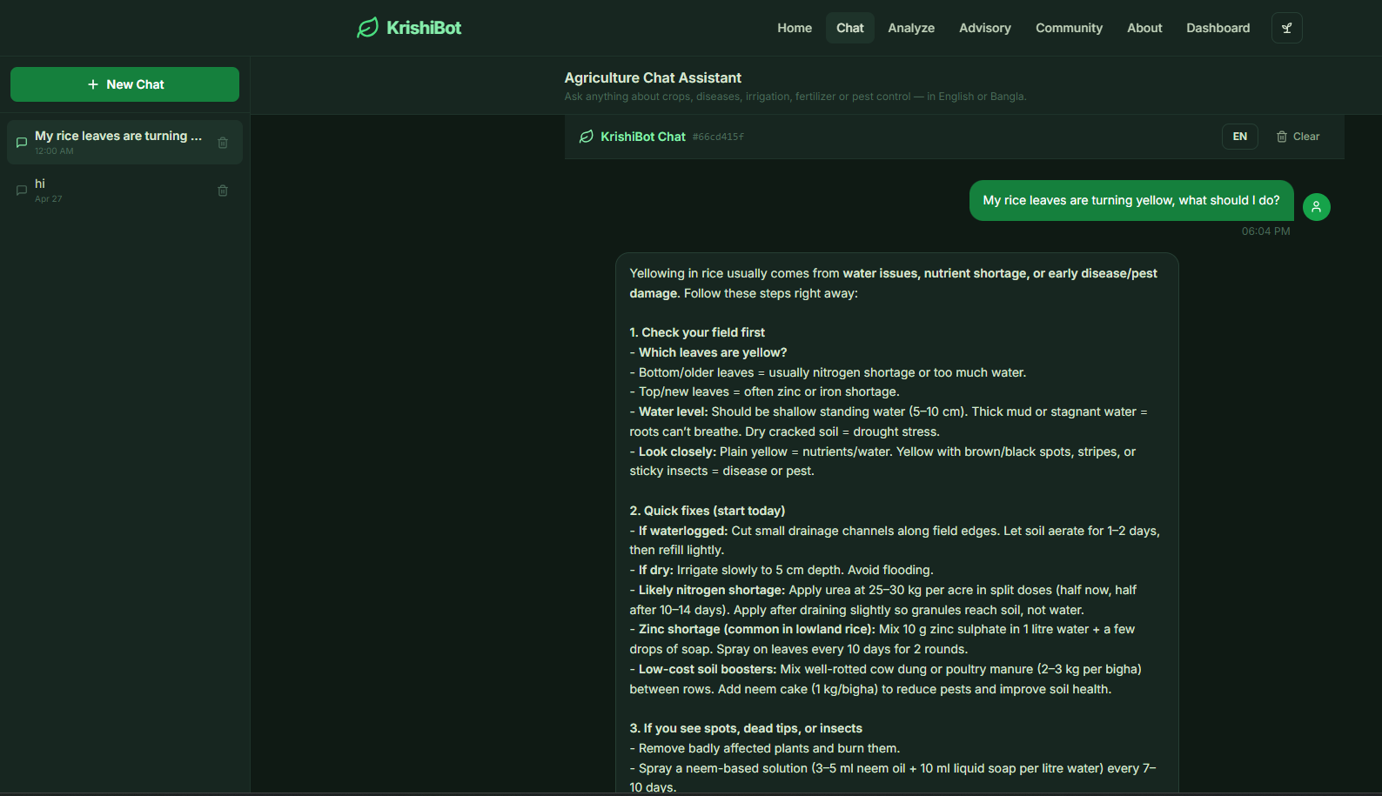
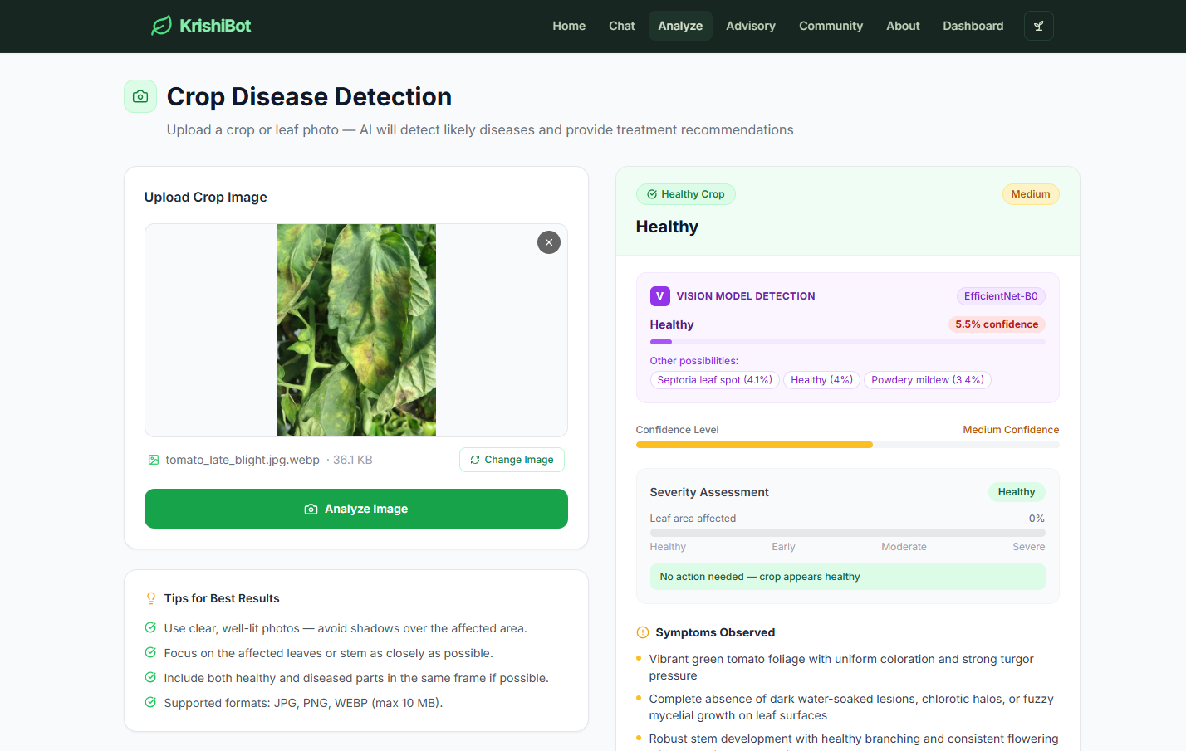
CSE499B | Section: 12 | Faculty: MSRB
MicroAgri-FP4
On-Device Agricultural Disease Intelligence
via Microscaling FP4 Quantization
KrishiBot Chat
MicroAgri
Android app + KrishiBot web platform for offline plant disease detection, Bangla advisory, and community disease awareness.
99.71%
6.7×
500+
100%
Classifier accuracy
Model compression
KB documents
Offline after setup
Disease Analysis
View Details
Late Blight
Tomato
Team Members
Md. Mahamudul Hassan [2121379642] • Mueid Islam Arian [2121947642] • Md. Nafiz Un Nabi Ishan [2121346042]
01

Slide 2
MicroAgri-FP4
CSE499B • Section 12 • Faculty: MSRB
Problem: farmers need fast diagnosis in the field
Bangladesh farmers can often treat diseases if they identify them early enough.
The bottleneck is not treatment — it is timely diagnosis.
Design Goals
16M
smallholder farmers in Bangladesh
• Offline-first operation
• Runs on low-resource Android phone
• Bangla voice input and output
• Actionable treatment, not generic advice
• Privacy-preserving local AI
• Limited access to agricultural experts
• Internet is unreliable in rural fields
• Most guidance is text-heavy and English-first
• Disease spreads before advice arrives
20–30%
annual crop loss from diseases
Low
connectivity + expert access
02

Slide 3
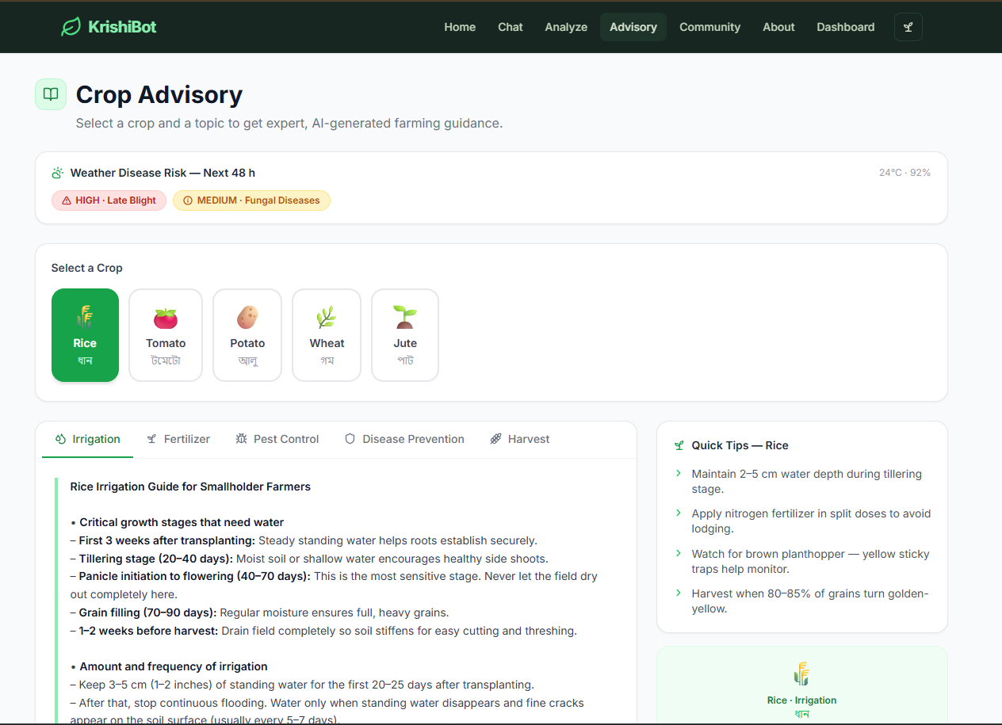
MicroAgri-FP4
CSE499B • Section 12 • Faculty: MSRB
Solution: two products, one agriculture AI ecosystem
The Android app handles field diagnosis; KrishiBot provides deeper advisory and records.
PRODUCT 01
PRODUCT 02
MicroAgri Android App
KrishiBot Web Platform
MicroAgri
MicroAgri
MicroAgri
বাংলায় বলুন
Weather Risk
Shared disease intelligence
HIGH
AI Chat
Analyze
View Details
🎤
Late Blight
Tomato
24°C • 92% humidity
Voice Input + Output
Advisory
Best for: real-time field diagnosis, zero-connectivity areas, low-literacy users.
Best for: extension officers, detailed analysis, PDFs, treatment calendar, and community reporting.
03

Slide 4
MicroAgri-FP4
CSE499B • Section 12 • Faculty: MSRB
System design: offline-first agricultural AI pipeline
Both products share the same idea: local AI + trusted knowledge + optional community awareness.
On-Device AI Core
Knowledge + Storage
MicroAgri App
KrishiBot Web
• DeiT-Tiny FP4 classifier
• MiniLM INT8 retriever
• Qwen2.5-0.5B INT4
• Whisper-tiny ONNX
• Android TTS
• 500+ trusted documents
• SQLite local records
• Disease prototypes
• Weather cache
• Diagnosis history
Camera / Gallery
Next.js Frontend
FastAPI Backend
Bangla Voice
Ollama + Qwen3B
Offline UI
SQLite + Reports
Design principle: farmer data stays local first; internet is only used for optional weather/community sync.
04

Slide 5
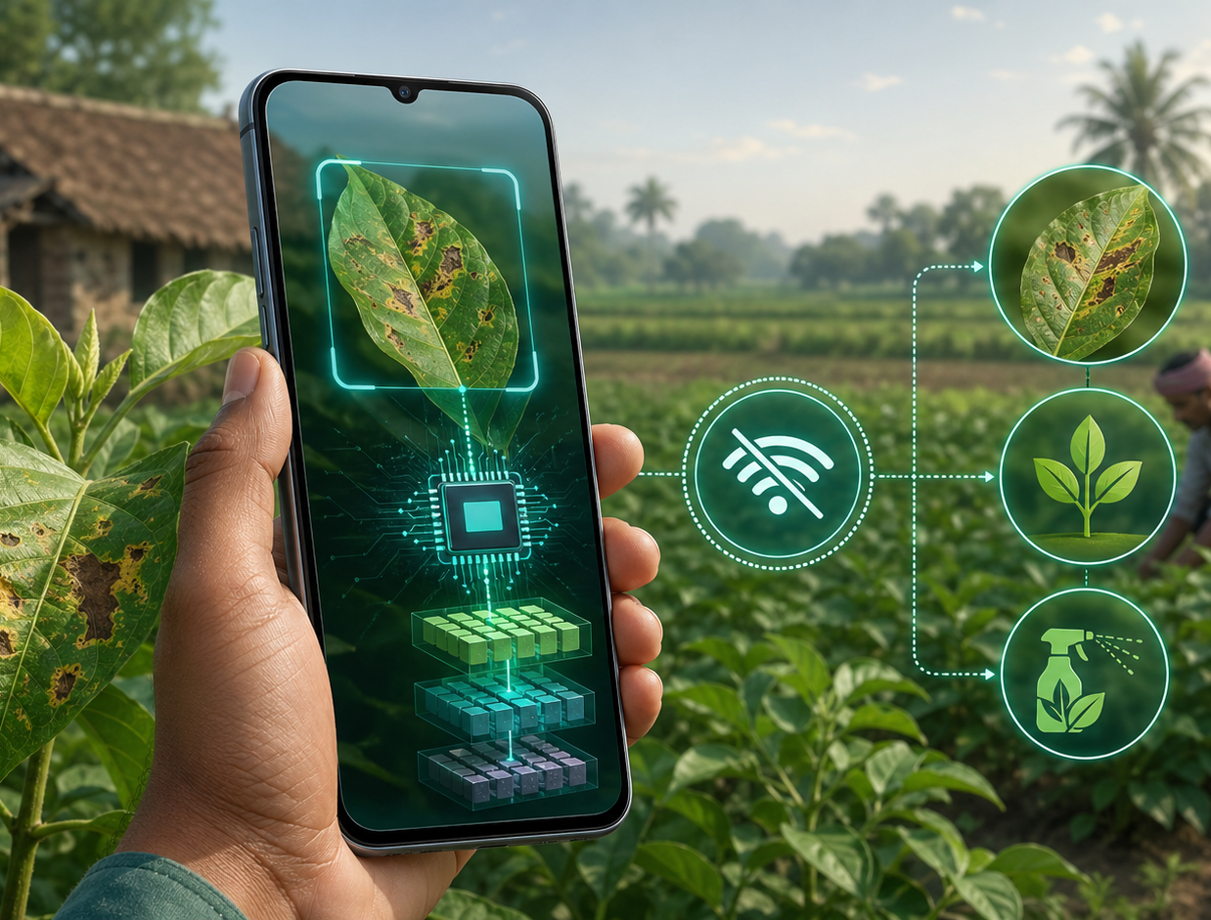
MicroAgri-FP4
CSE499B • Section 12 • Faculty: MSRB
MicroAgri app: field diagnosis workflow
A farmer scans a leaf, receives a disease result, listens in Bangla, and follows treatment advice.
1
Scan leaf
CameraX capture or gallery upload.
Why it fits farmers
Run classifier
• No cloud dependency after setup
• Runs on mid-range Android
• Low data cost and private records
• Designed for Bangla interaction
2
FP4 DeiT-Tiny predicts from 15 disease classes on-device.
3
Retrieve advice
MiniLM searches trusted UC Davis IPM, BARI and FAO knowledge chunks.
4
Speak result
5 sec
Bangla voice input/output reduces reading dependency.
target end-to-end flow
05

Slide 6
MicroAgri-FP4
CSE499B • Section 12 • Faculty: MSRB
MicroAgri results: accuracy, compression, and device readiness
The main contribution is preserving accuracy while shrinking the ViT model for mobile deployment.
Key results
Model size comparison
Metric
Result
Meaning
100
Top-1 Accuracy
99.71%
Reliable classifier
Compression
6.7×
Mobile-friendly
Final Weights
3.17 MB
Loads in phone RAM
Knowledge Base
500+ docs
Grounded advice
15
Operation
Offline
Field usable
FP32
FP4
Normalized size: FP4 is about 15% of the original model after 6.7× compression.
06

Slide 7
MicroAgri-FP4
CSE499B • Section 12 • Faculty: MSRB
MicroAgri AI modules inside the app
The app is more than a classifier: it combines vision, RAG, speech, weather and few-shot adaptation.
📷
Vision Classifier
🎤
Speech
DeiT-Tiny ViT, NVFP4/MXFP4 quantized, ONNX Runtime + NNAPI.
Whisper-tiny for Bangla ASR; Android TTS reads advice aloud.
Performance target
<3s
📚
Retriever
🌤
Risk Engine
MiniLM-L6-v2 INT8 searches a local 500+ document knowledge base.
Weather cache converts humidity/temp into disease risk alerts.
classifier inference
0 MB
✍️
Generator
🧬
Few-Shot
server data needed
Qwen2.5-0.5B INT4 produces grounded treatment guidance.
3–10 examples create new disease prototypes stored in SQLite.
Result: a practical Android tool for low-connectivity farming environments.
07

Slide 8
MicroAgri-FP4
CSE499B • Section 12 • Faculty: MSRB
KrishiBot web platform: deeper advisory and reporting
KrishiBot supports browser-based disease analysis, chat, advisory, PDF export and community reporting.
Main capabilities
• Qwen2.5 3B local chat
• Image upload + structured report
• Severity stage and symptoms
• 14-day treatment calendar
• Market-price viability
• PDF diagnosis report
• Community disease board
Image-Based Disease Analysis
Chat Assistant
08

Slide 9
MicroAgri-FP4
CSE499B • Section 12 • Faculty: MSRB
KrishiBot results: response speed and feature evaluation
The web platform was tested locally with Qwen2.5 3B served through Ollama.
Measured performance
Speed comparison
Metric
Result
18
First chat token
2–4 sec
15
Streaming speed
15–25 tok/s
Disease analysis
8–15 sec
4
Treatment calendar
10–18 sec
1
PDF generation
<1 sec
PDF
Chat
Analysis
Calendar
RAM usage
~3.5–4 GB
Lower is faster. PDF export is immediate; AI generation takes longer but remains usable for advisory workflows.
09

Slide 10
MicroAgri-FP4
CSE499B • Section 12 • Faculty: MSRB
KrishiBot modules: organized for real farming decisions
The web platform turns diagnosis into action: risk, treatment, cost and community awareness.
🌤
Weather Risk
High humidity + cool temperature triggers late blight alerts; rainfall raises fungal risk.
Trusted sources
• UC Davis IPM
• BARI knowledge
• FAO guidance
• Open-Meteo weather
• Local SQLite records
📅
Treatment Calendar
Positive diagnosis automatically generates a 14-day spray and care schedule.
💰
Market Context
Compares crop value, likely yield loss and treatment cost before recommending action.
Crop Advisory + Weather Risk
Community Board
👥
Local AI + practical advice
Anonymous disease reports help farmers and officers see outbreak patterns by division.
10

Slide 11
Conclusion
MicroAgri-FP4 shows that agricultural AI can be accurate, offline, low-cost and practical for Bangladeshi smallholder farmers.
Impact
Research contribution
Future work
• Early diagnosis can reduce crop loss
• Bangla voice makes guidance accessible
• Offline AI protects privacy and cuts cost
• Community reporting improves awareness
• First FP4 study applied to ViT in this project context
• 6.7× compression with 99.71% accuracy
• 3.17 MB weights enable mobile deployment
• More crops and disease classes
• GradCAM heatmap for explainability
• GPS outbreak map and live market prices
• Federated learning for updates
Empowering farmers. Strengthening food security. Building smarter agriculture.
11

